Slide 1

Progress update
-Timothy Allen

Slide 2
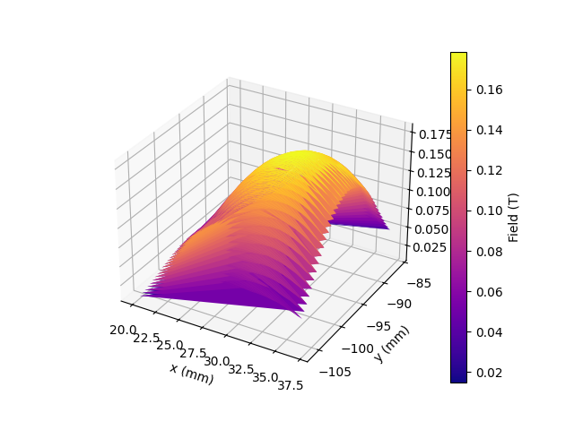
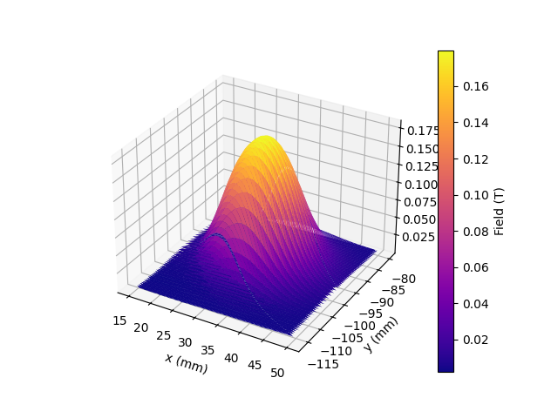
Mag Mapper
Issues with taking rectangular grid measurements
PM8 measurement taken during day, large errors
PM8 measurement taken overnight, slices still clear

Slide 3
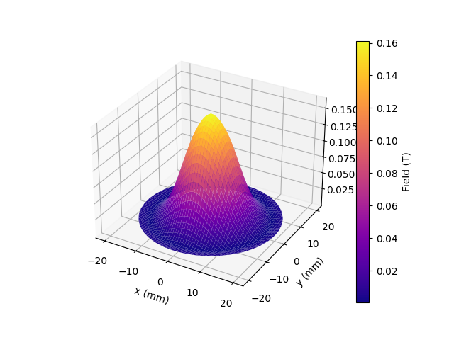
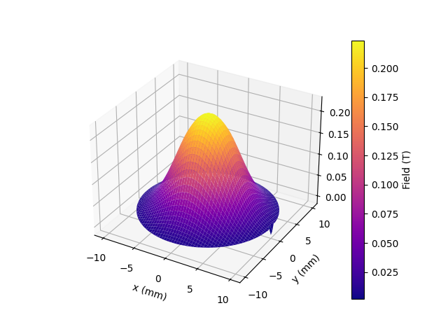
Rotational measurements
PM8 (from previous page) measured with rotation, slight lip and potentially missing centre
PM9

Slide 4
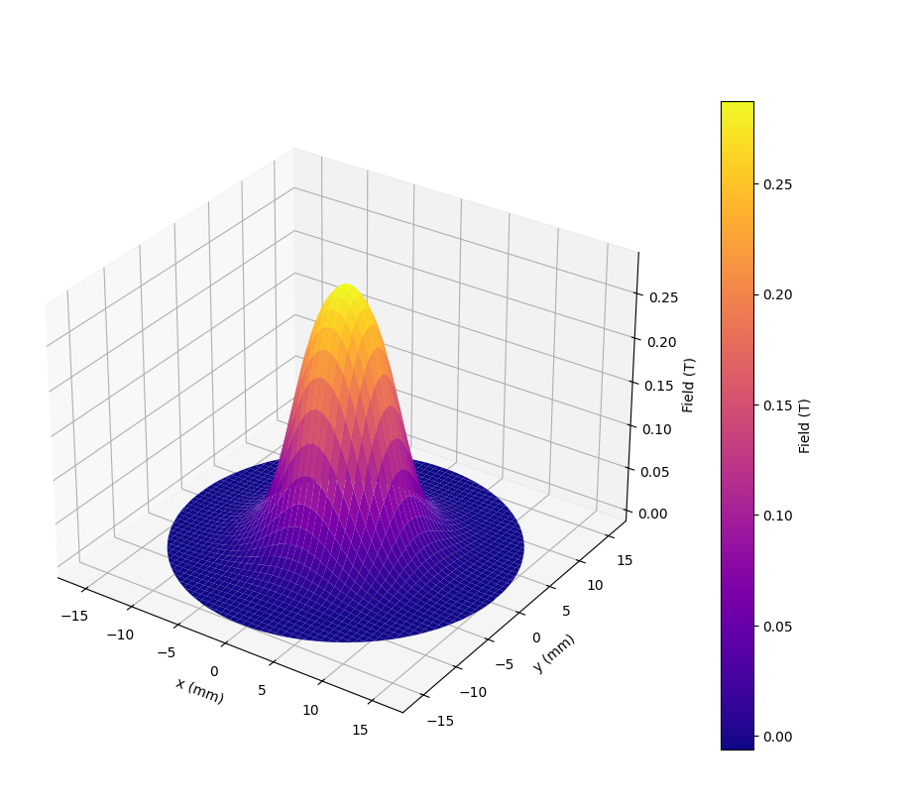
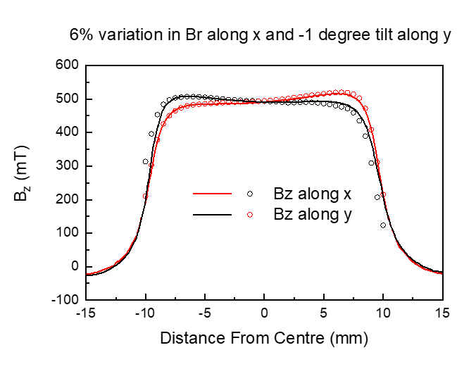
Volumes and slices with new magnets
Magnet Inhomogeneity
y
Br 1.44 T
Br 1.36 T
x
One slice of PM10, lack of inhomogeneity
Working towards

Slide 5

Tinius Olsen
Rewiring
Future work

